Slide 1
Brazilian Culture
Julio Barros EID:01963387

Slide 2
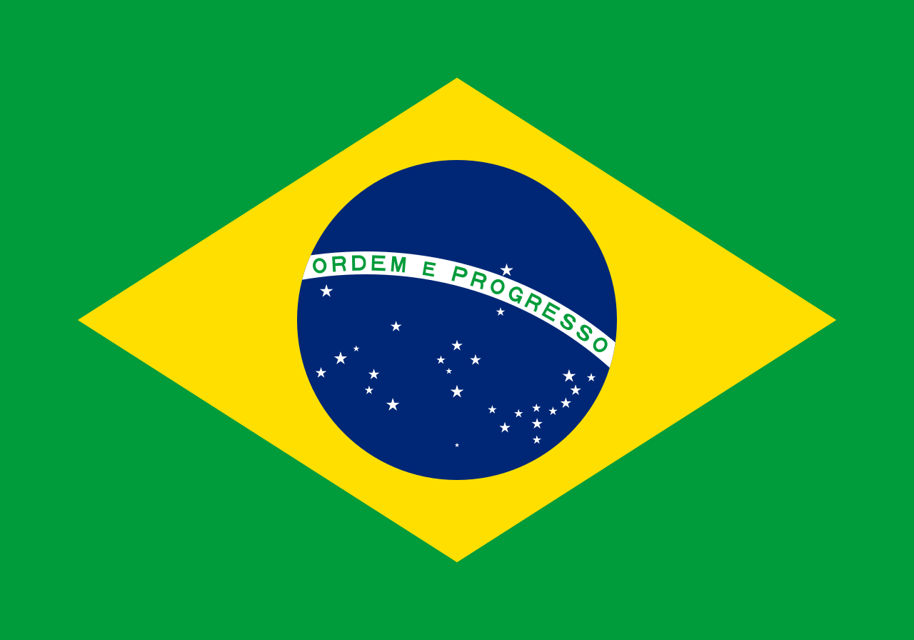
The Official Language in Brazil is Portuguese
Brazil, a former Portuguese colony, is the only South American country that does not speak Spanish. It is home to more than half of the South American population at 201,032,714.

Slide 3
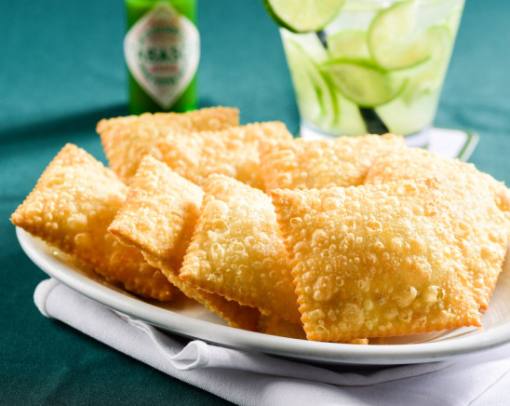
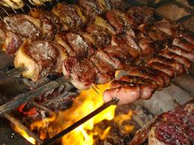
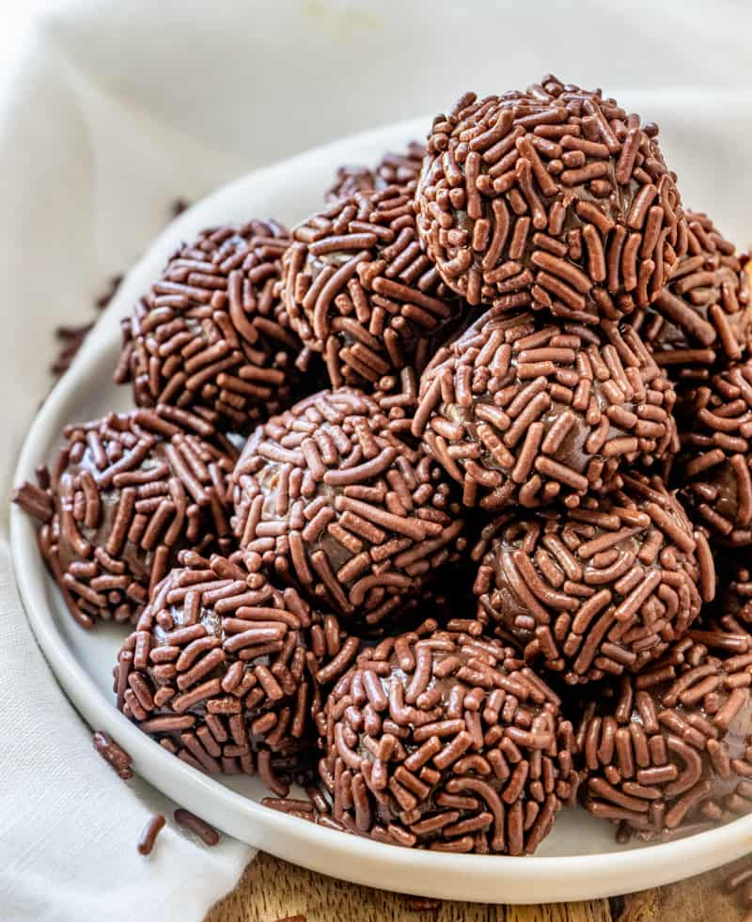
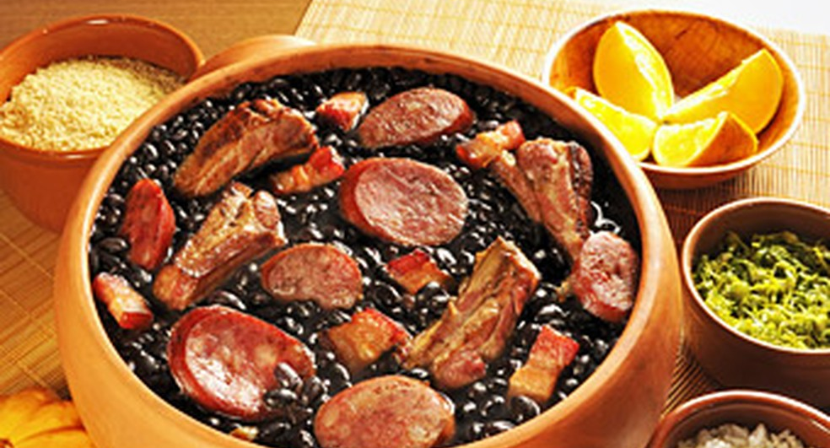
Traditional Dishes
There are thousands of Brazilian Dishes that are famous around the world here there are my Four favorite ones;
Pastel.
Churrasco.
Feijoada.
Brigadeiro.

Slide 4
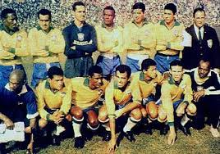
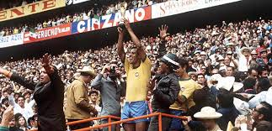
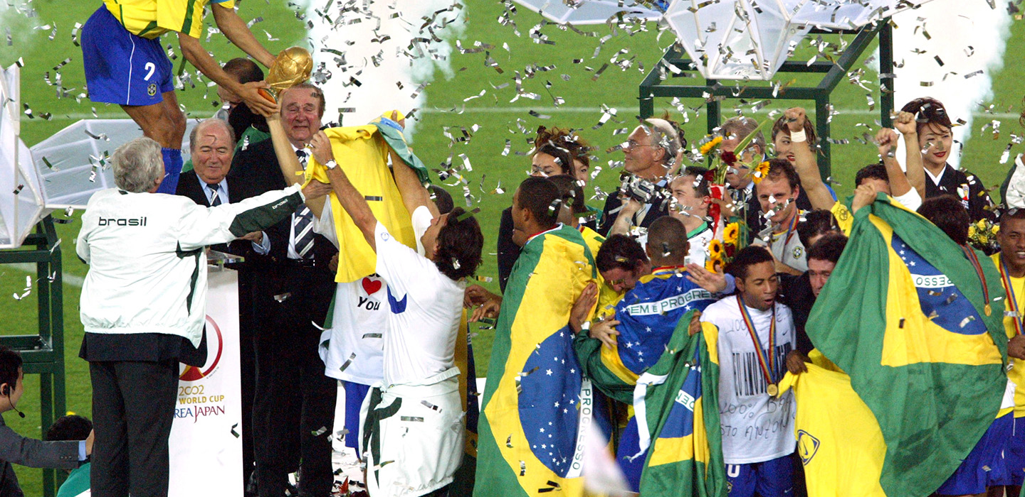
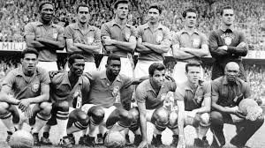
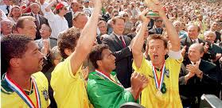
Soccer
1958
1970
Brazil is considerate the country of soccer and the reason for it, is we are the only country who participated all the World Cups and we are the most victorious nation with 5 titles.
2002
1962
1994

